Slide 1
Basic Concepts in Number Theory and Finite Fields
Divisibility and the Division Algorithm
The Euclidean Algorithm
Groups, Rings, and Fields
Finite Fields of the Form GF(p)
Polynomial Arithmetic

Slide 2
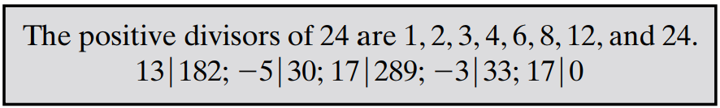
Divisibility
We say that a nonzero b divides a if a = mb for some m, where a, b, and m are integers. That is, b divides a if there is no remainder on division.
The notation b|a is commonly used to mean b divides a (or b is a divisor of a)

Slide 3
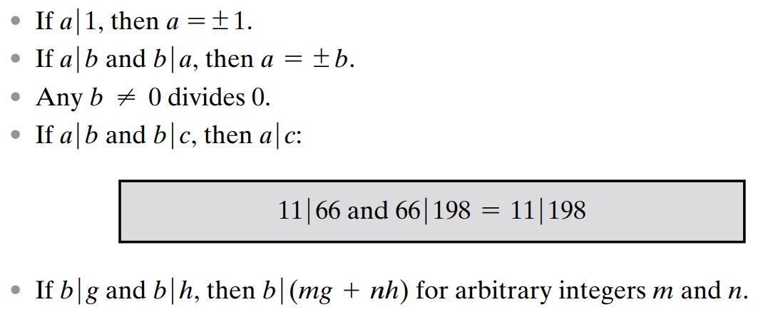
Divisibility Properties

Slide 4
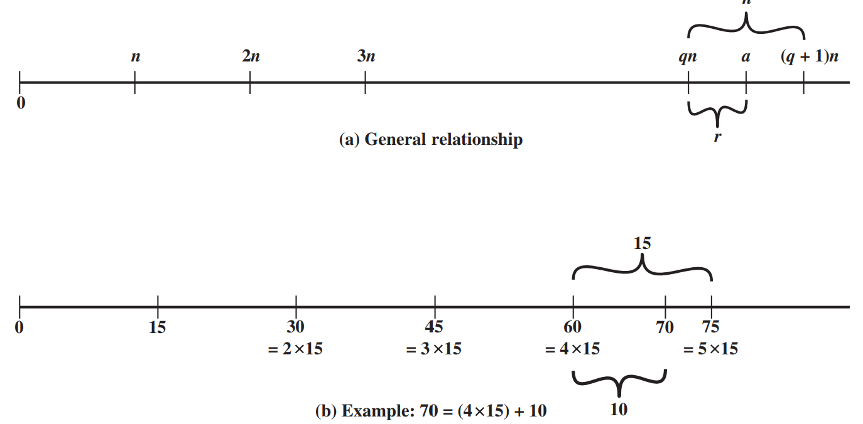
Division Algorithm
For any positive integer n and any nonnegative(i.e. positive and 0) integer a, if we divide a by n, we get an integer quotient q and an integer remainder r that obey the following relationship:
a = qn + r ; 0 ≤ r < n; q = [ a|n]

Slide 5
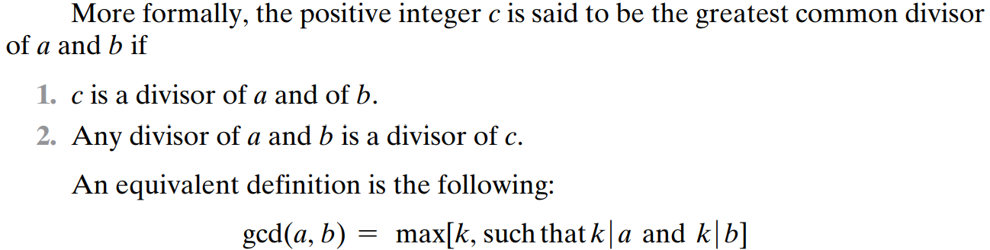
Greatest Common Divisor (GCD)
The greatest common divisor of a and b is the largest integer that divides both a and b. We also define gcd(0, 0) = 0
Relatively Prime definition: Two integers are relatively prime if their only common positive integer factor is 1

Slide 6
The Euclidean Algorithm
It is simple procedure for determining the greatest common divisor (GCD) of two positive integers
Suppose we have integers a, b such that d = gcd(a, b).
Because gcd(|a|,|b| ) = gcd(a, b), there is no harm in assuming a ≥ b > 0.
Now dividing a by b and applying the division algorithm, we can state:

Slide 7
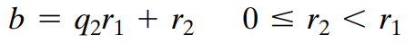
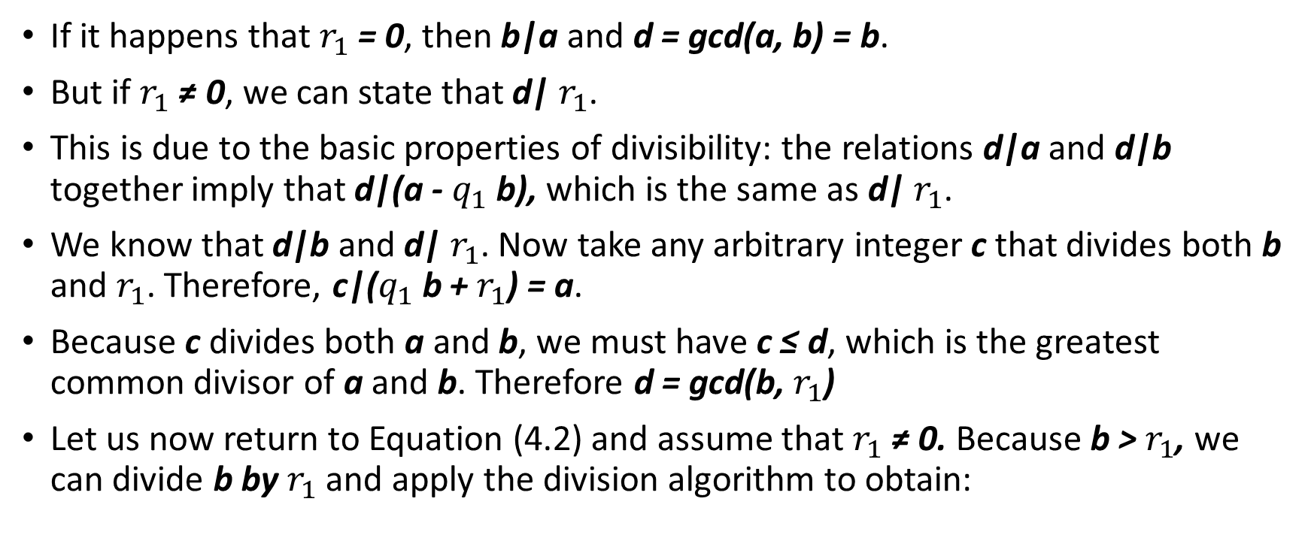
The Euclidean Algorithm
If it happens that $r_{1}$ = 0, then b|a and d = gcd(a, b) = b.
But if $r_{1}$ ≠ 0, we can state that d| $r_{1}$.
This is due to the basic properties of divisibility: the relations d|a and d|b together imply that d|(a - $q_{1}$b), which is the same as d| $r_{1}$.
We know that d|b and d| $r_{1}$. Now take any arbitrary integer c that divides both b and $r_{1}$. Therefore, c|($q_{1}$b + $r_{1}$) = a.
Because c divides both a and b, we must have c ≤ d, which is the greatest common divisor of a and b. Therefore d = gcd(b, $r_{1}$)
Let us now return to Equation (4.2) and assume that $r_{1}$ ≠ 0. Because b > $r_{1}$, we can divide b by $r_{1}$ and apply the division algorithm to obtain:

Slide 8
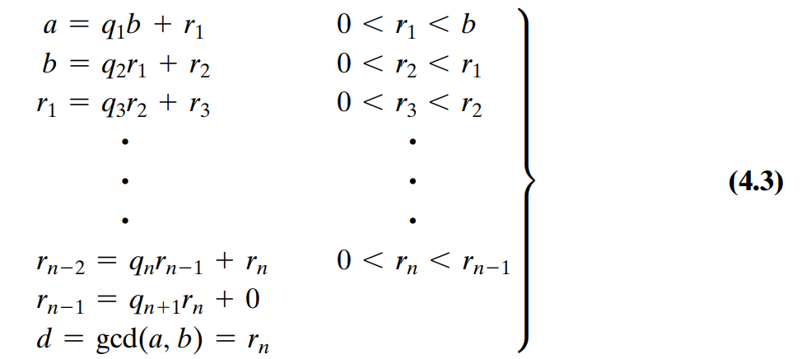
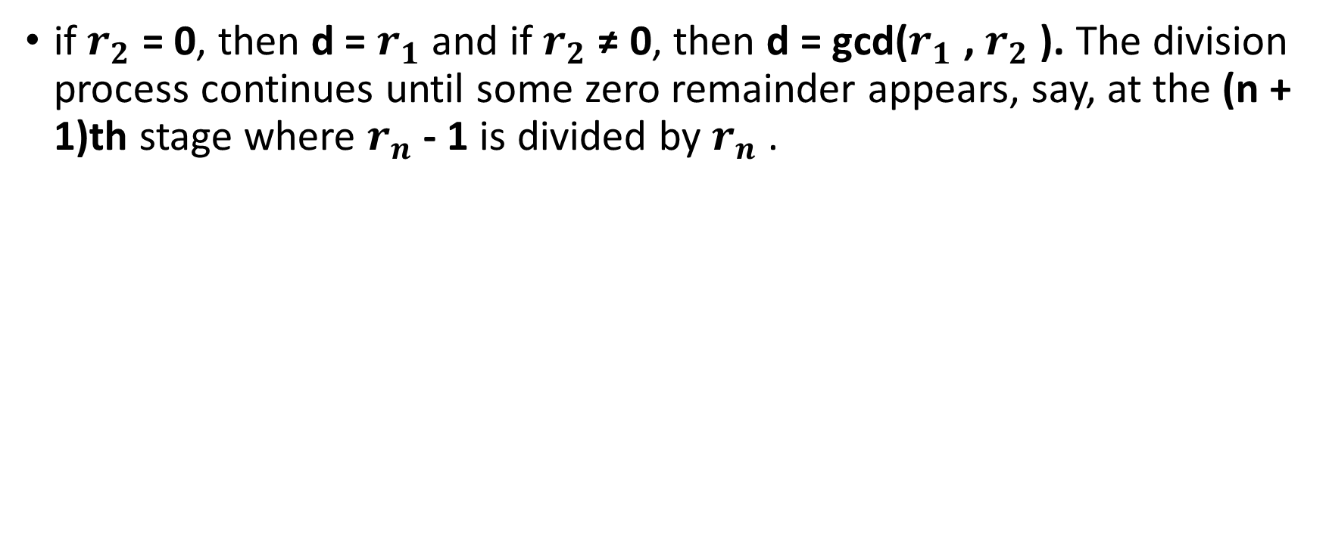
The Euclidean Algorithm
if $r_{2}$ = 0, then d = $r_{1}$ and if $r_{2}$ ≠ 0, then d = gcd($r_{1}$ , $r_{2}$ ). The division process continues until some zero remainder appears, say, at the (n + 1)th stage where $r_{n}$ - 1 is divided by $r_{n}$ .

Slide 9
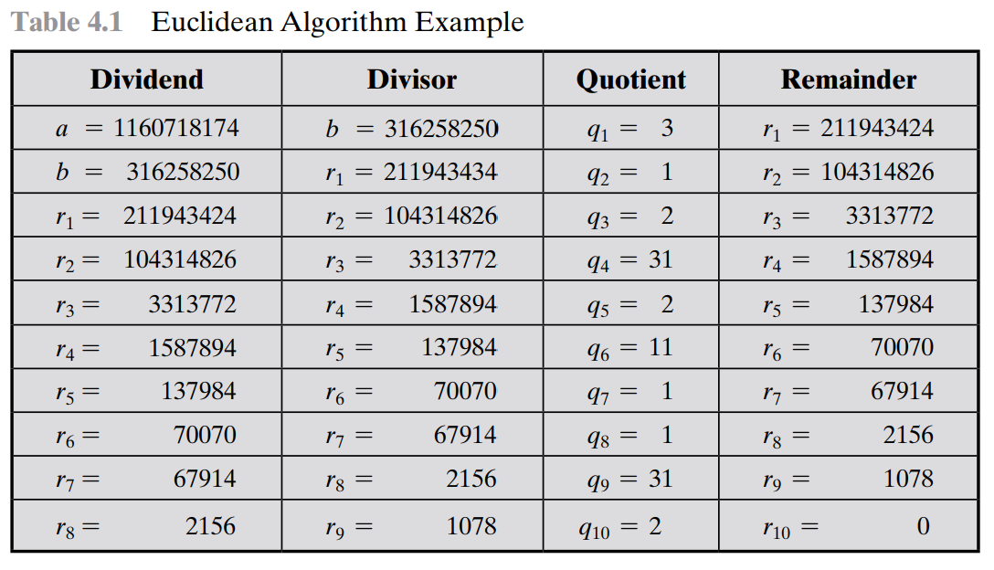
Euclidean Algorithm Method 1

Slide 10
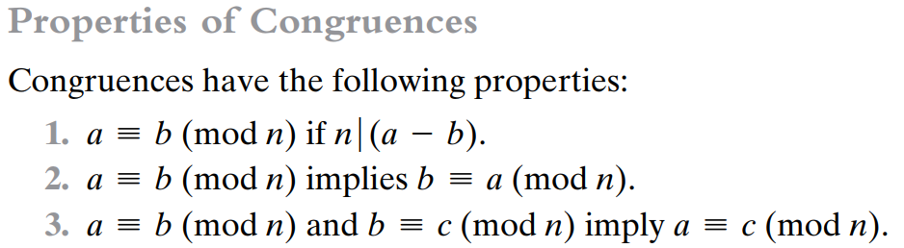
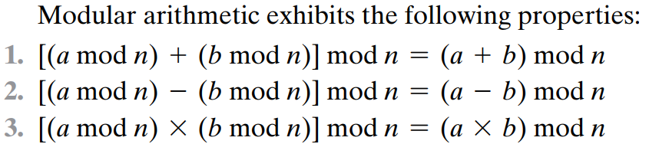
MODULAR ARITHMETIC
If a is an integer and n is a positive integer, we define a mod n to be the remainder when a is divided by n. The integer n is called the modulus.
Two integers a and b are said to be congruent modulo n, if (a mod n) = (b mod n). This is written as a ≡ b (mod n)
if a ≡ 0 (mod n), then n|a

Slide 11
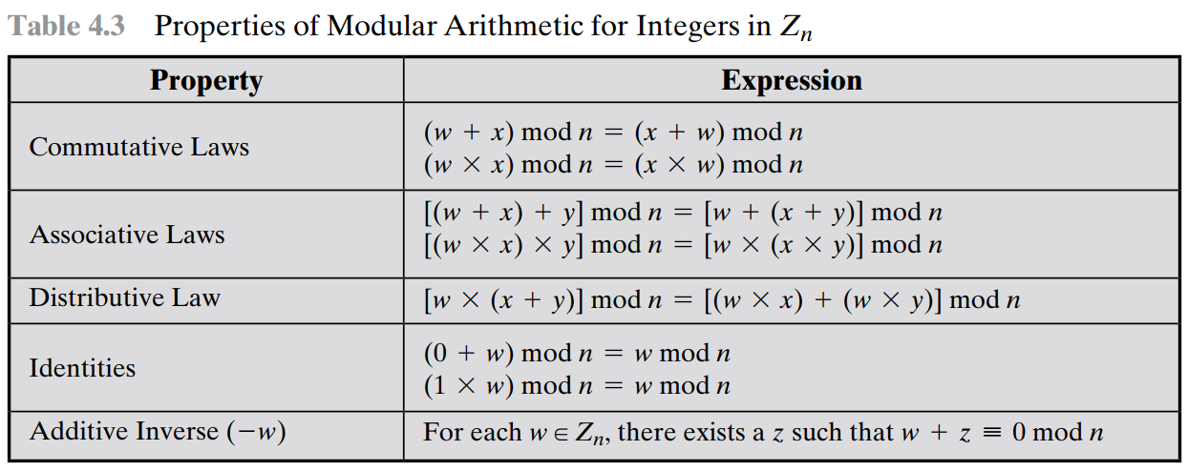
Properties of Modular Arithmetic for Integers in Zn
Define the set Zn as the set of nonnegative integers less than n:
Zn = {0, 1, c, (n - 1)}

Slide 12
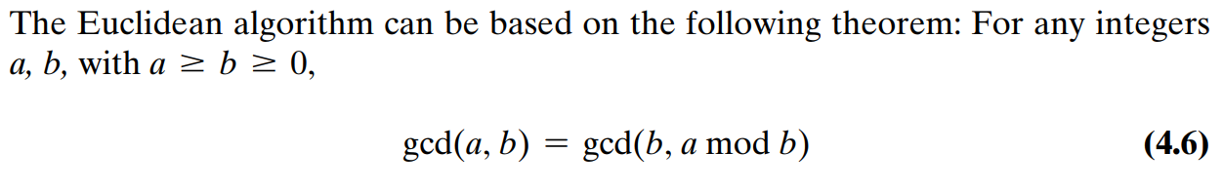
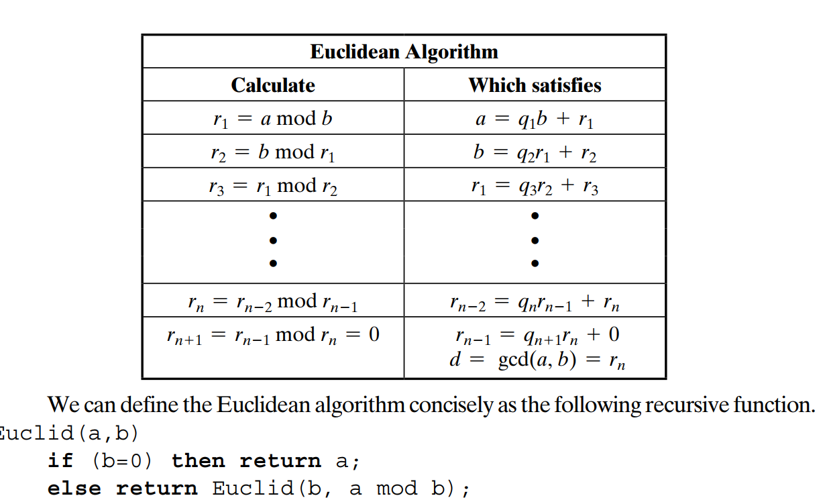
Euclidean Algorithm Method 2

Slide 13
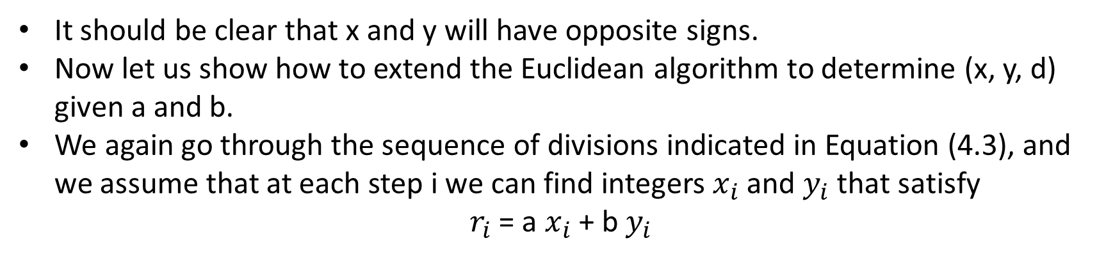
The Extended Euclidean Algorithm
For given integers a and b, the extended Euclidean algorithm not only calculate the greatest common divisor d but also two additional integers x and y that satisfy the following equation:
It should be clear that x and y will have opposite signs.
Now let us show how to extend the Euclidean algorithm to determine (x, y, d) given a and b.
We again go through the sequence of divisions indicated in Equation (4.3), and we assume that at each step i we can find integers $x_{i}$ and $y_{i}$ that satisfy
$r_{i}$ = a $x_{i}$ + b $y_{i}$

Slide 14
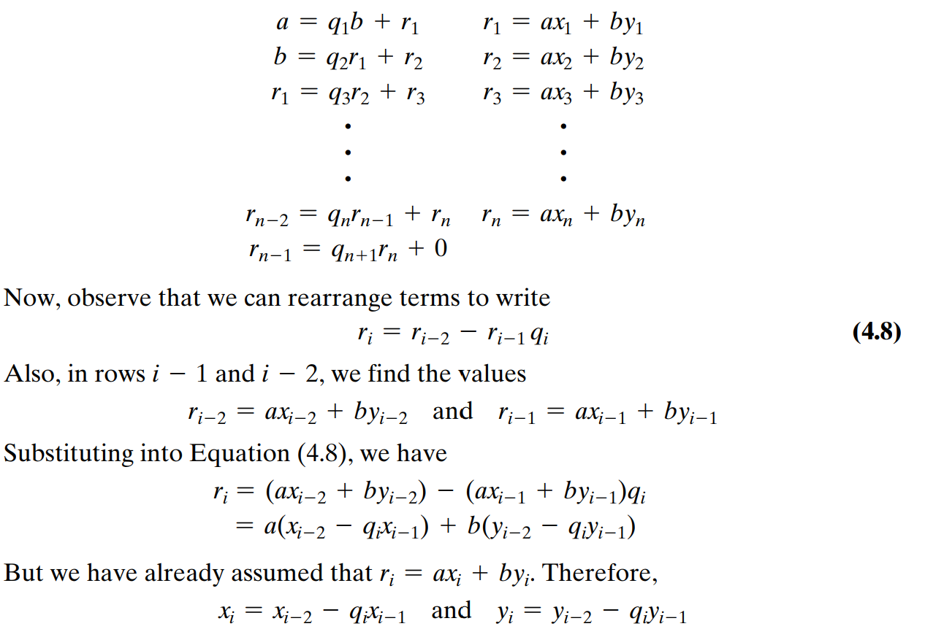
The Extended Euclidean Algorithm
Now we end up with the following sequence:

Slide 15
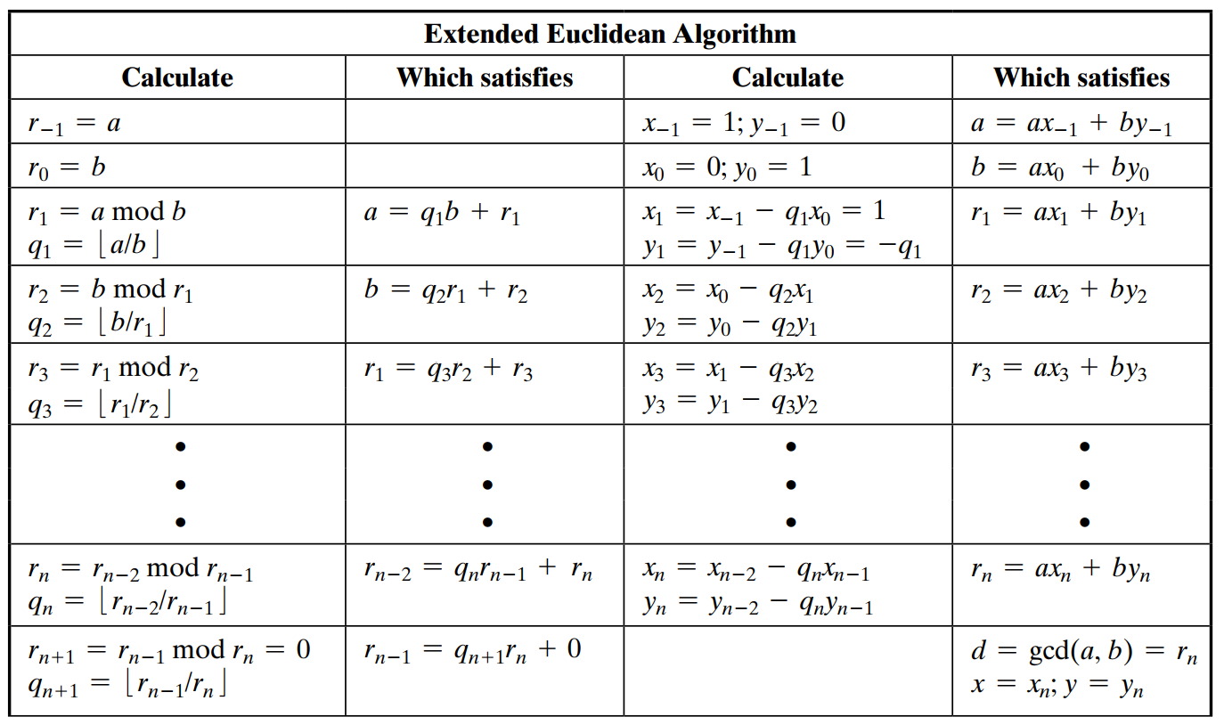
Summarize Extended Euclidean Algorithm

Slide 16
Finding the Multiplicative Inverse
If a and b are relatively prime, then b has a multiplicative inverse modulo a.
That is, if gcd(a, b) = 1, then b has a multiplicative inverse modulo a.
We know that :
Now, if gcd(a, b) = 1, then we have ax + by = 1.
Using the basic equalities of modular arithmetic, we can say
[(ax mod a) + (by mod a)] mod a = 1 mod a
0 + (by mod a) = 1

Slide 17
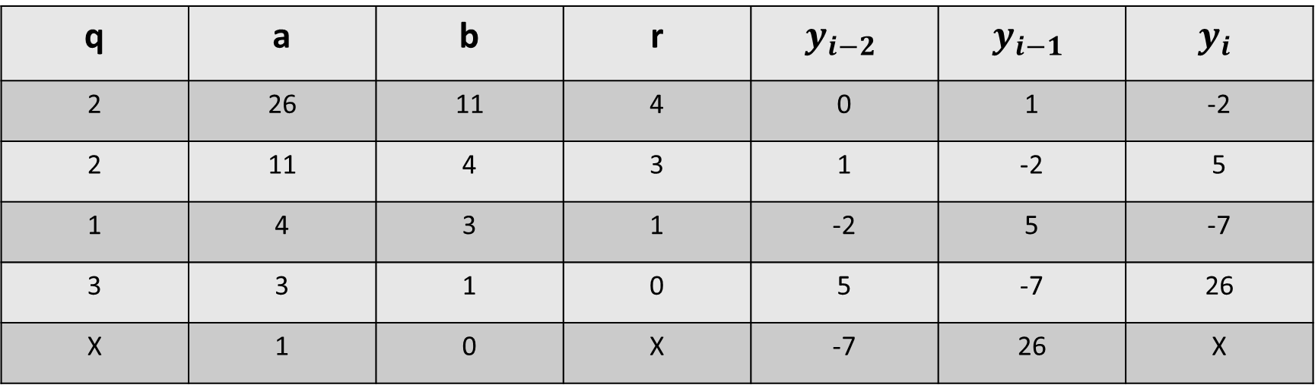
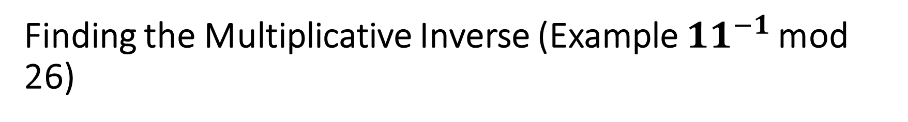
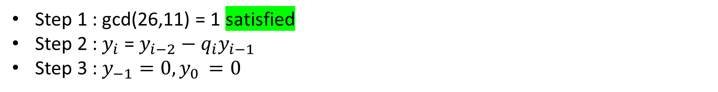
Finding the Multiplicative Inverse (Example ${11}^{−1 }$mod 26)
Step 1 : gcd(26,11) = 1 satisfied
Step 2 : $y_{i}$ = $y_{i−2}−{q_{i}y}_{i−1}$
Step 3 : $y_{−1}=0,y_{0 }=0$
q | a | b | r | $$y_{i−2}$$ | $$y_{i−1}$$ | $$y_{i}$$
2 | 26 | 11 | 4 | 0 | 1 | -2
2 | 11 | 4 | 3 | 1 | -2 | 5
1 | 4 | 3 | 1 | -2 | 5 | -7
3 | 3 | 1 | 0 | 5 | -7 | 26
X | 1 | 0 | X | -7 | 26 | X

Slide 18
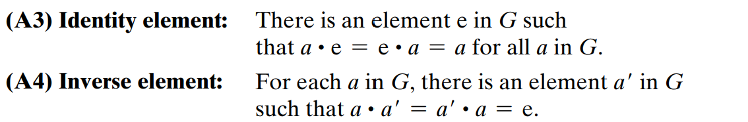
Groups
Groups, rings, and fields are the fundamental elements of a branch of mathematics known as abstract algebra, or modern algebra.
A group G, sometimes denoted by {G, }, is a set of elements with a binary operation denoted by that associates to each ordered pair (a, b) of elements in G an element (a b) in G, such that the following axioms are obeyed :

Slide 19
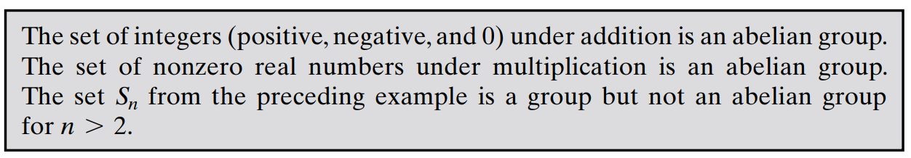
Groups
If a group has a finite number of elements, it is referred to as a finite group, and the order of the group is equal to the number of elements in the group. Otherwise, the group is an infinite group.

Slide 20
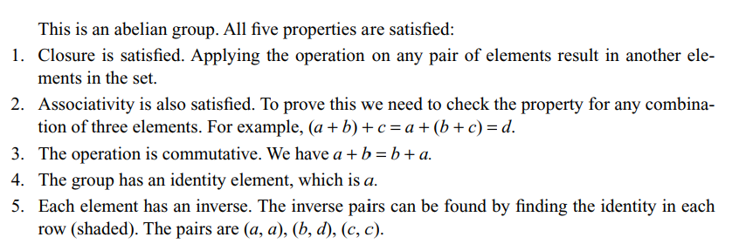
Example
Let us define a set G = < {a, b, c, d}, •> and the operation as shown

Slide 21
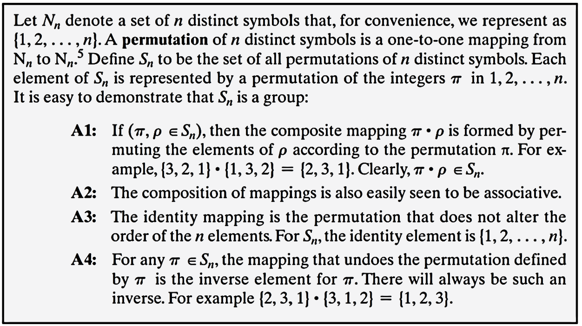

Groups

Slide 22
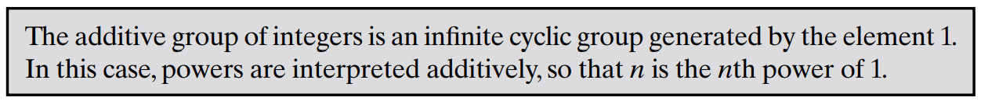
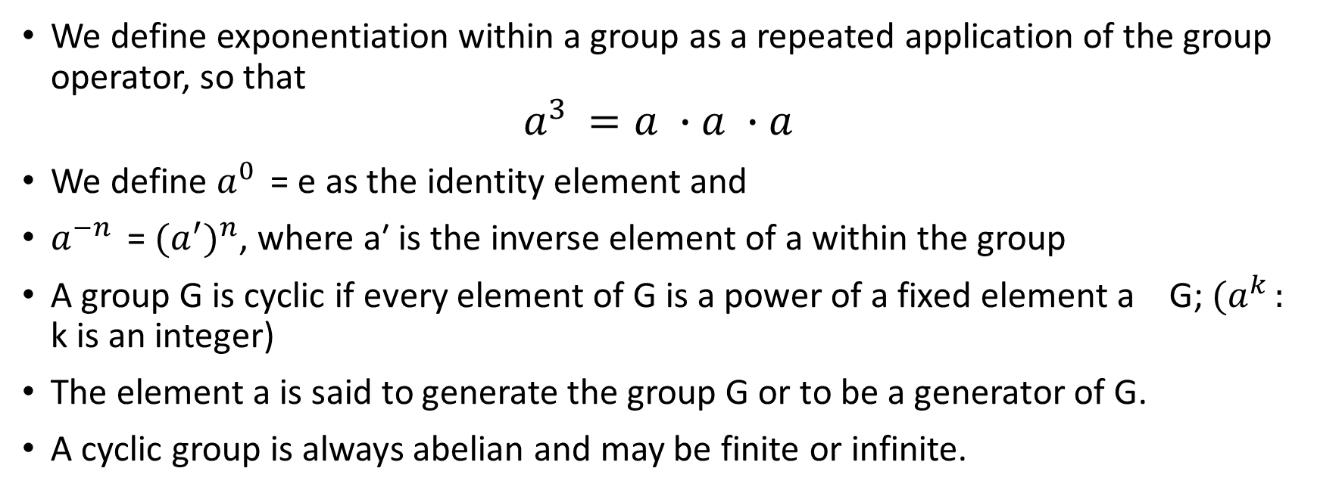
Cyclic Group
We define exponentiation within a group as a repeated application of the group operator, so that
$$a^{3 }=a ∙a ∙a$$
We define $a^{0 }$ = e as the identity element and
$a^{−n }$ = ${{(a}^{′})}^{n}$, where a′ is the inverse element of a within the group
A group G is cyclic if every element of G is a power of a fixed element a G; ${(a}^{k }:$ k is an integer)
The element a is said to generate the group G or to be a generator of G.
A cyclic group is always abelian and may be finite or infinite.

Slide 23
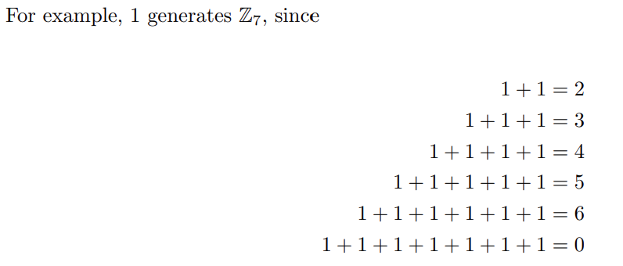
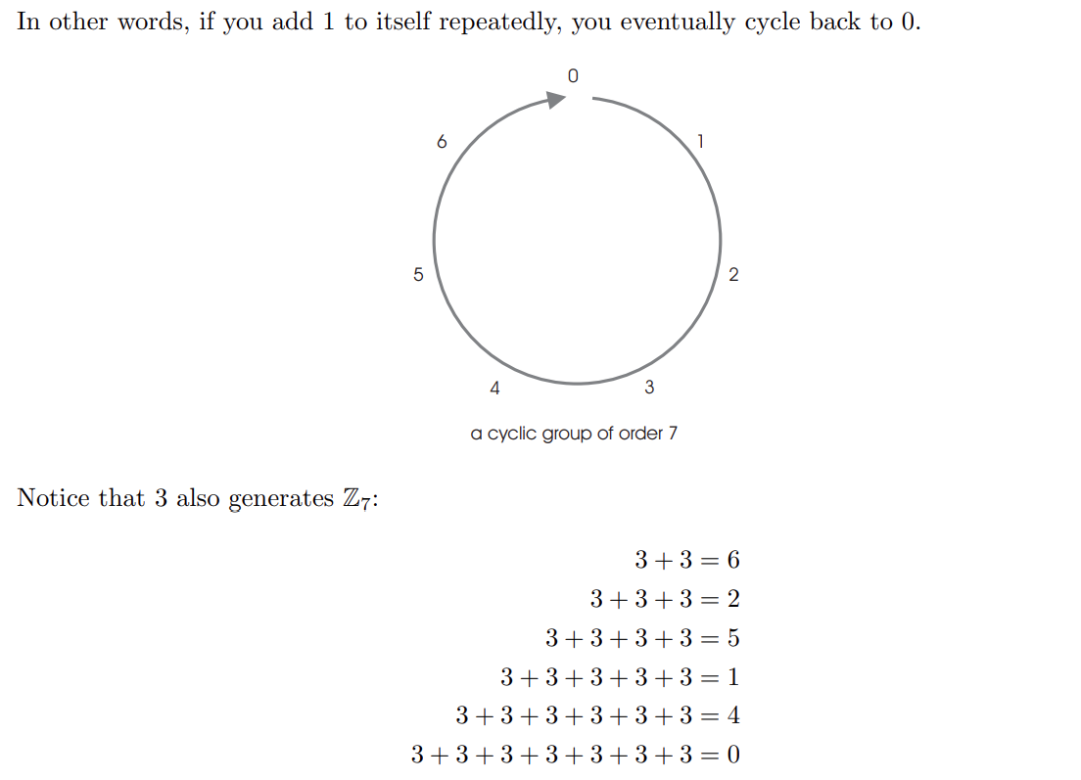

Slide 24
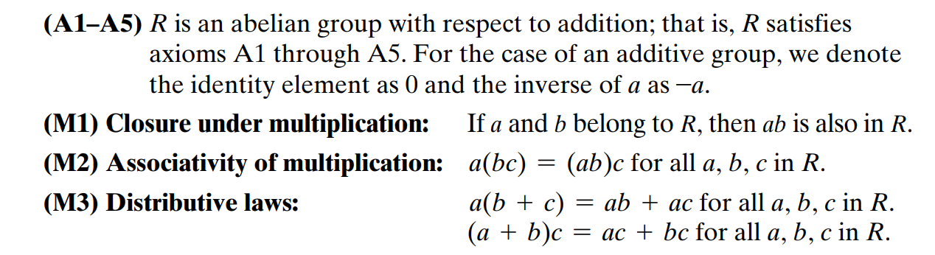
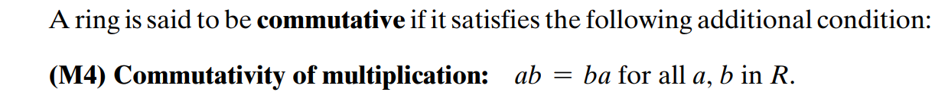
Rings
A ring R, sometimes denoted by {R, +, *}, is a set of elements with two binary operations, called addition and multiplication, such that for all a, b, c in R the following axioms are obeyed.

Slide 25
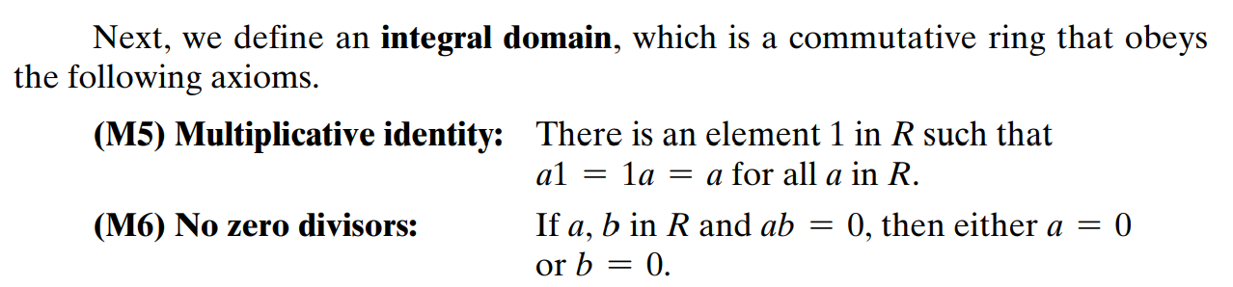
Rings

Slide 26
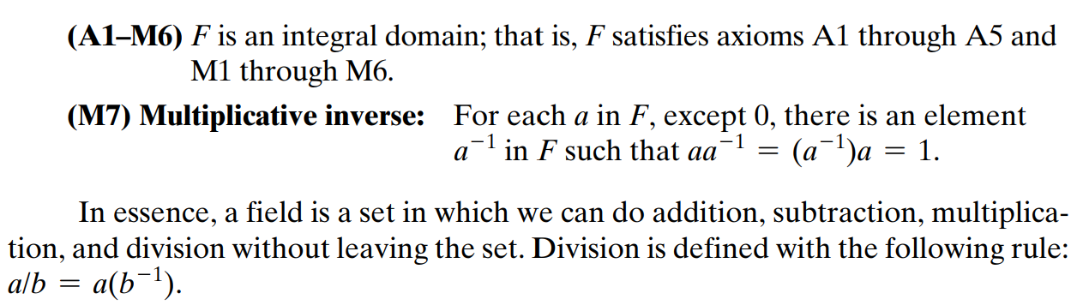
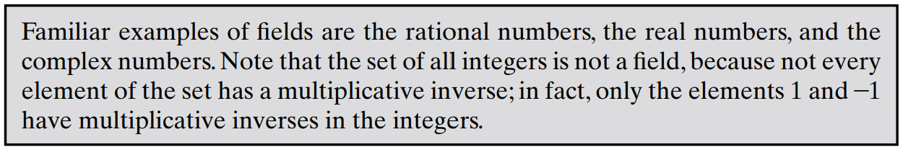
Fields
A field F, sometimes denoted by {F, +, *}, is a set of elements with two binary operations, called addition and multiplication, such that for all a, b, c in F the following axioms are obeyed.

Slide 27
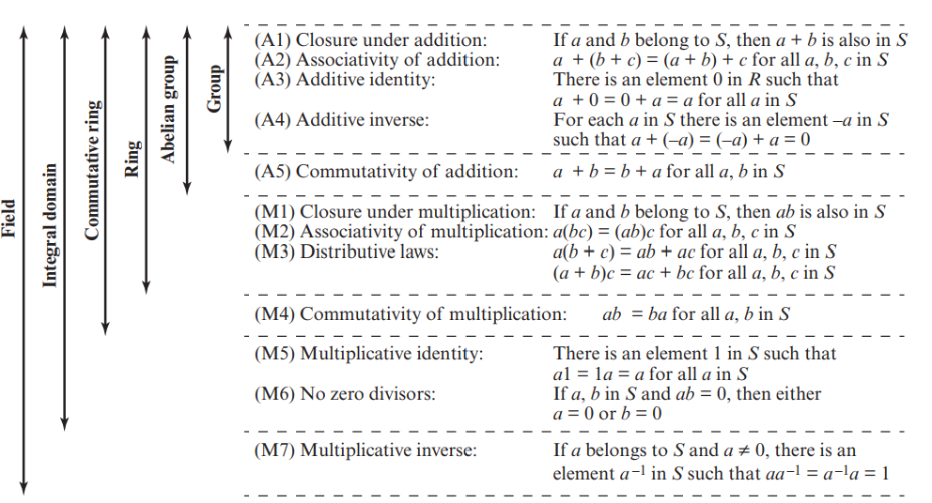
Properties of Groups, Rings, and Fields

Slide 28
The main difference between groups and rings is that rings have two binary operations (usually called addition and multiplication) instead of just one binary operation.
If you forget about multiplication, then a ring becomes a group with respect to addition (the identity is 0 and inverses are negatives). This group is always commutative!
If you forget about addition, then a ring does not become a group with respect to multiplication. The binary operation of multiplication is associative and it does have an identity 1, but some elements like 0 do not have inverses. (This structure is called a monoid.)
A commutative ring is a field when all nonzero elements have multiplicative inverses. In this case, if you forget about addition and remove 0, the remaining elements do form a group under multiplication. This group is again commutative.
A division ring is a (not necessarily commutative) ring in which all nonzero elements have multiplicative inverses. Again, if you forget about addition and remove 0, the remaining elements do form a group under multiplication. This group is not necessarily commutative. An example of a division ring which is not a field are the quaternions.

Slide 29
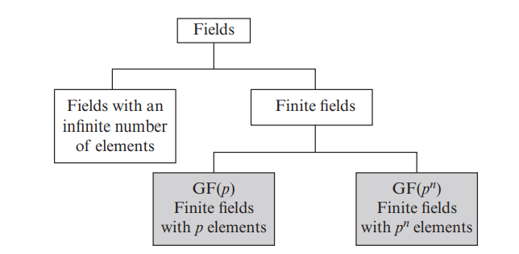
Types of Fields

Slide 30
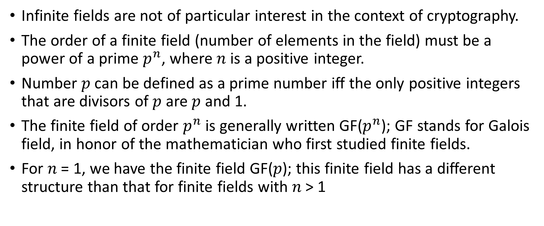
Finite Fields of the Form GF(p)
Infinite fields are not of particular interest in the context of cryptography.
The order of a finite field (number of elements in the field) must be a power of a prime $p^{n}$, where $n$ is a positive integer.
Number 𝑝 can be defined as a prime number iff the only positive integers that are divisors of 𝑝 are 𝑝 and 1.
The finite field of order $p^{n}$ is generally written GF($p^{n}$); GF stands for Galois field, in honor of the mathematician who first studied finite fields.
For 𝑛 = 1, we have the finite field GF(𝑝); this finite field has a different structure than that for finite fields with 𝑛 > 1

Slide 31
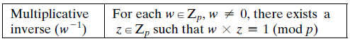
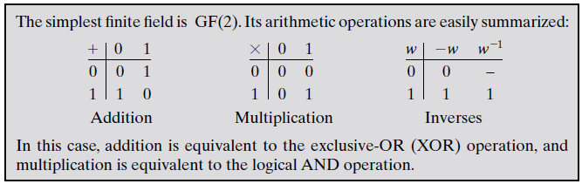
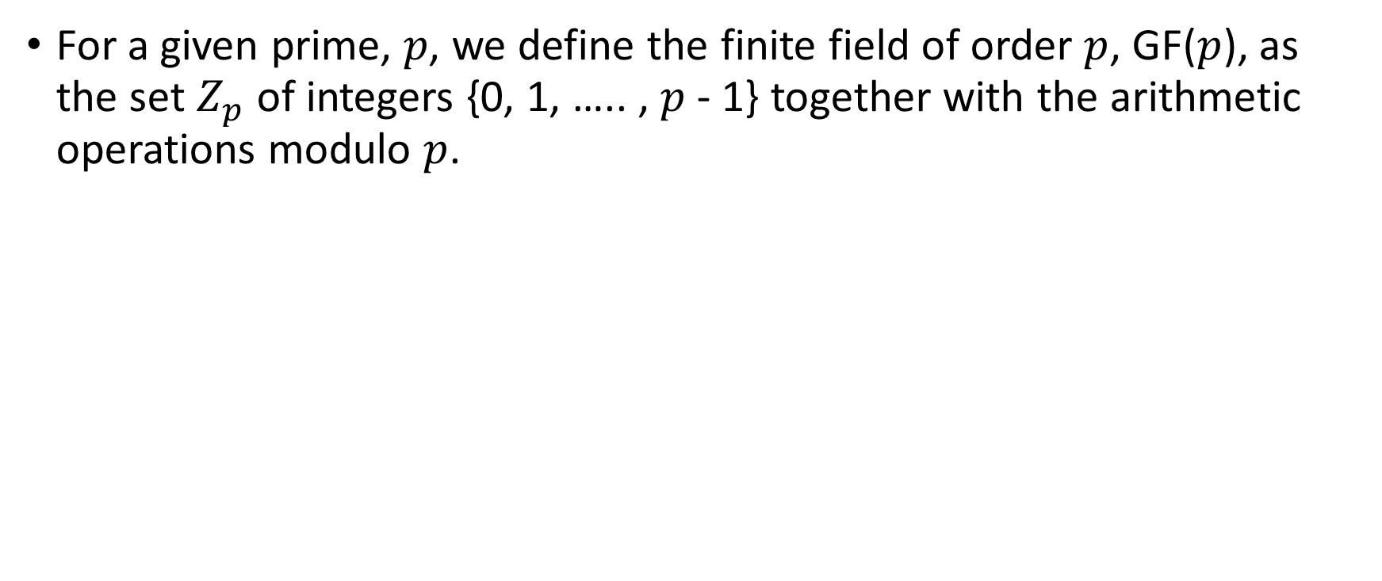

Finite Fields of Order $p$
For a given prime, 𝑝, we define the finite field of order $p$, GF($p$), as the set $Z_{p}$ of integers {0, 1, ….. , $p$ - 1} together with the arithmetic operations modulo $p$.

Slide 32
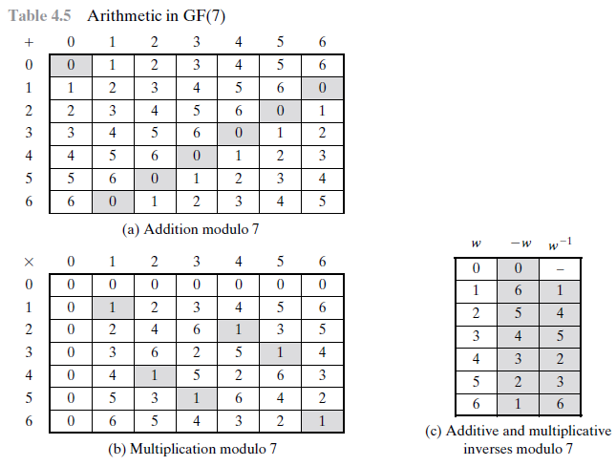

Slide 33
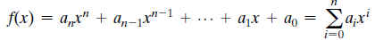
Polynomial Arithmetic
can compute using polynomials
Note: not interested in any specific value of x
x is the indeterminate …like an unspecified base
several alternatives available
ordinary polynomial arithmetic
poly arithmetic with coefficients mod p
poly arithmetic with coefficients mod p and polynomials mod m(x)

Slide 34
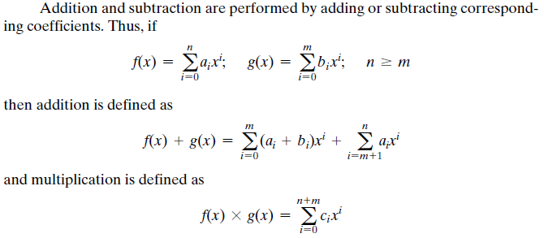
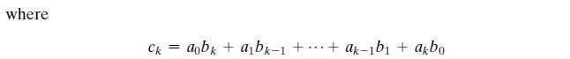
Ordinary Polynomial Arithmetic

Slide 35
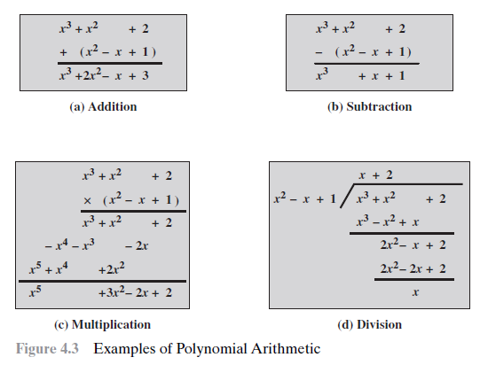

Slide 36
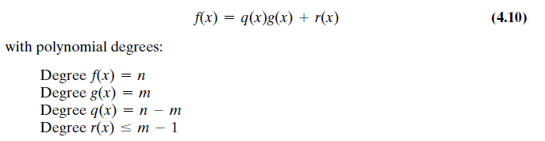
Division Algorithm for Polynomial
Given polynomials f(x) of degree n and g(x) of degree (m), (n ≥ m), if we divide f(x) by g(x), we get a quotient q(x) and a remainder r(x) that obey the relationship

Slide 37
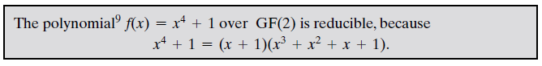
Irreducible Polynomial
A polynomial f(x) over a field F is called irreducible if and only if : f(x) cannot be expressed as a product of two polynomials, both over F, and both of degree lower than that of f(x)
By analogy to integers, an irreducible polynomial is also called a prime polynomial.

Slide 38
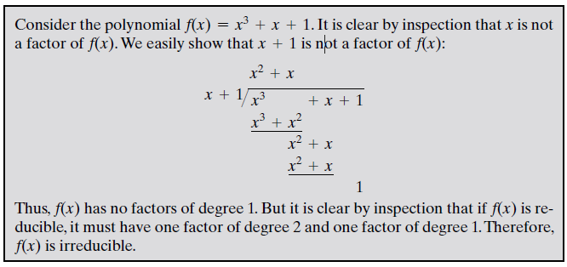
Irreducible Polynomial

Slide 39
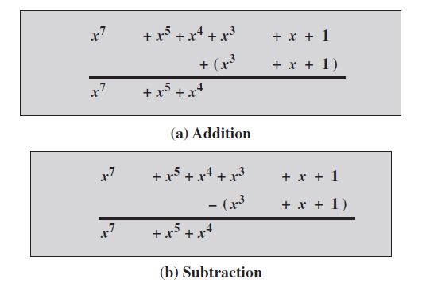
Examples of Polynomial Arithmetic over GF(2)

Slide 40
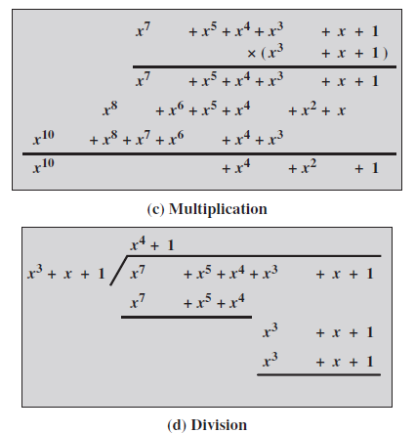
Examples of Polynomial Arithmetic over GF(2)

Slide 41
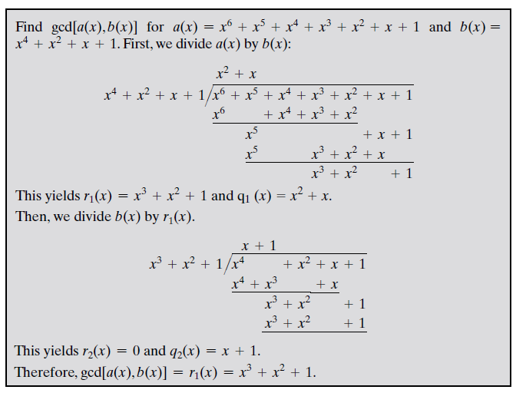
Finding the Greatest Common Divisor

Slide 43


FINITE FIELDS OF THE FORM GF($2^{n}$)
Virtually all encryption algorithms, both symmetric and public key, involve arithmetic operations on integers.
If one of the operations that is used in the algorithm is division, then we need to work in arithmetic defined over a field.
For convenience and for implementation efficiency, we would also like to work with integers that fit exactly into a given number of bits with no wasted bit patterns.
That is, we wish to work with integers in the range 0 through $2^{n}$ - 1, which fit into an n-bit word.

Slide 44

FINITE FIELDS OF THE FORM GF($2^{n}$)

Slide 45


Slide 46


Slide 47


Slide 48

Modular Polynomial Arithmetic

Slide 49


Slide 50



Slide 51


Slide 52

Computational Considerations : ADDITION
We have seen that addition of polynomials is performed by adding corresponding coefficients, and, in the case of polynomials over , addition is just the XOR operation.

Slide 53

Computational Considerations : MULTIPLICATION

Slide 54

Using a Generator
A generator g of a finite field F of order q (contains q elements) is an element whose first q-1 powers generate all the nonzero elements of F.

Slide 55

Using a Generator

Slide 56

Using a Generator

Slide 57


